Slide 1
Build an Atom Demos for pre-lesson and clicker questions for post-lesson Trish Loeblein 6/14/2011 http://phet.colorado.edu/
Learning Goals- Students will be able to:
Make atom models that show stable atoms or ions.
Use given information about subatomic particles to
Identify an element and its position on the periodic table
Draw models of atoms
Determine if the model is for a neutral atom or an ion.
Predict how addition or subtraction of a proton, neutron, or electron will change the element, the charge, and the mass of their atom or ion.
Describe all vocabulary words needed to meet the goals.
Use a periodic symbol to tell the number of protons, neutrons, and electrons in an atom or ion.
Draw the symbol for the element as you would see on the periodic table

Slide 2
Rules
The toothpick must have a marshmallow on each end
Each part must be used.

Slide 3
1. What can you make with 2 marshmallows and one toothpick ?

Slide 4
1a. What would you call this?

Slide 5
2. What can you make with 3 marshmallows and 3 toothpicks ?

Slide 6
2a. What would you call this?

Slide 7
3. What can you make with 4 marshmallows and 4 toothpicks ?

Slide 8
3a.What would you call this?

Slide 9
4. How many marshmallows and how many toothpicks would you need to make a box?

Slide 10
4a. 8 marshmallows and 12 sticks

Slide 11
Clicker questions for Post-Lesson

Slide 12
1. What can you make with 4 protons and 4 neutrons?
Oxygen atom
Oxygen ion
Beryllium atom
Beryllium ion
2 of these
Notes:
E there are 4 protons so atom or ion is ok; oxygen has a atomic number of 8, so I used it for a distractor.

Slide 13
2. Would you predict that 4 protons and 4 neutrons will make a stable nucleus?
No, because the net charge
is high
No, because there should always be more protons than neutrons
Yes, because the number of protons and neutrons are about equal
Notes:
C electrons (net charge) is an independent variable to nuclear stability

Slide 14
3. If you have 5 protons & 6 neutrons, how many electrons would you add to make a neutral atom ?
5 electrons
6 electrons
11 electrons
Notes:
A

Slide 15
3. Reasoning: Neutrons don’t matter because they have zero charge; need equal number of protons and electrons

Slide 16
4. What is mass for an atom with 8 protons, 9 neutrons and 8 electrons?
?
Zero
8
16
17
25
Notes:
D

Slide 17
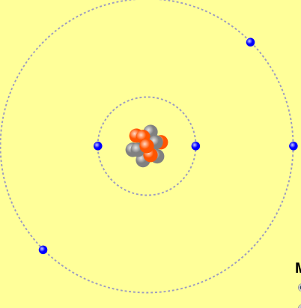
5. If you have 5 protons, 6 neutrons, & 5 electrons, what would the symbol look like?
A B C D
Notes:
A

Slide 18
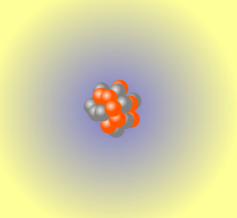
6. If you have 8 protons, 9 neutrons, 10 electrons, what would the atom or ion be?
Zero, it’s an atom
+2 ion
+1 ion
-1 ion
-2 ion
Notes:
C

Slide 19
7. If you have 3 protons, 4 neutrons, & 3 electrons, what would the model look like?
3 red & 3 blue in center; 4 grey on rings
3 red & 4 grey in center; 3 blue on rings
3 blue & 4 grey in center; 3 red on rings
Notes:
B

Slide 20
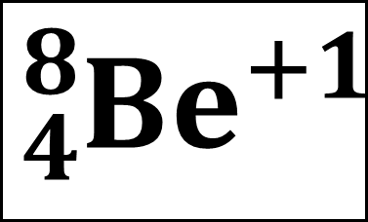
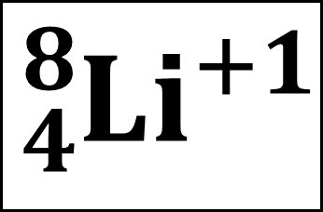
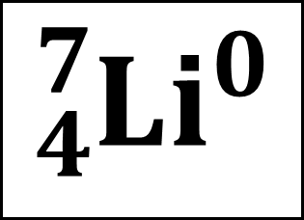
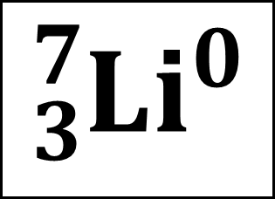
8. If a particle has 3 protons, 4 neutrons, & 3 electrons, then a proton is added what would the symbol be?
$${{}_{3}^{7}{Li}}^{0}$$
$${{}_{4}^{7}{Li}}^{0}$$
$${{}_{4}^{8}{Li}}^{+1}$$
$${{}_{4}^{8}{Be}}^{+1}$$
A B C D
Notes:
D

